Slide 1
WISE Buyer versus Conspicuous Consumer

Slide 2
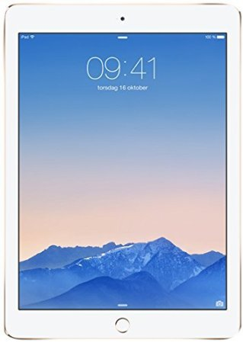
Conspicuous Buy: IPad Air
Apple iPad Air 2 (64GB)
Price: $554
Why is it conspicuous?
The IPad is the most wanted tablet in the market
Why is it expensive?
This IPad has 64gb and is the newest model

Slide 3
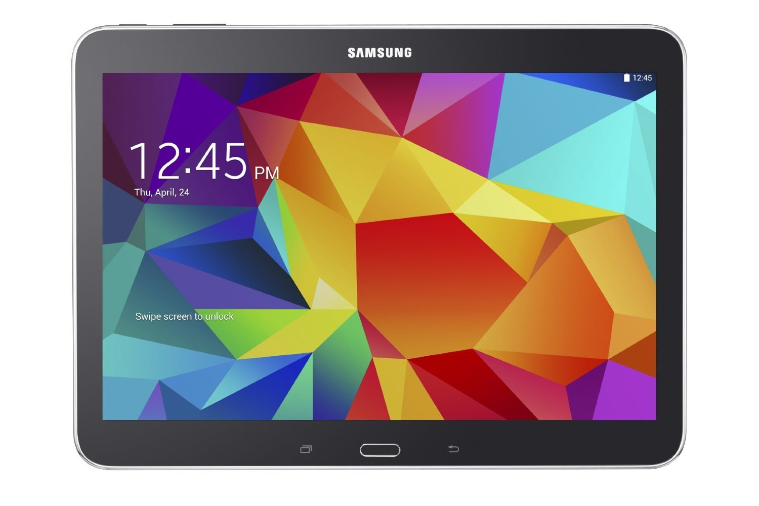
Wise Buy: Samsung Galaxy
Samsung Galaxy Tab 16gb
Price: $244.99
Why is it WISE?
This tablet is cheaper but has similar functions
I sacrifice GB space but I don’t need them.

Slide 4
Conspicuous Buy: Jordan Men's Air Jordan 7 Retro Basketball Shoe
Nike Jordan Men's Air Jordan 7 Retro Basketball Shoe.
Price: $800
Why is it conspicuous?
Jordan is the most wanted and popular shoe in the market.
Why is it expensive?
Michael Jordan is a famous basketball player and Jordan is his shoes.

Slide 5
Wise Buy: Jordan Air Incline Basketball Shoe
Boys Jordan Air Incline Basketball Shoe.
Price: $114.99
Why is it wise?
This shoe is less expensive but it’s from the brand with similar quality.

Slide 6
Conspicuous Buy: High Heels
NIB**CHRISTIAN LOUBOUTIN**AMAZING**LADY PEEP STRASS**37.5
Price: $ 4,225.00
Why is it conspicuous?
Christian Louboutin is a French famous footwear designer whose footwear has incorporated shiny, red-lacquered soles that have become his signature.
Why is it expensive?
It was designed exclusively by Christian and each individual crystal was hand placed.

Slide 7
Wise Buy: Crystal Beaded Women's High Heels
Fashion Fish mouth Pearl Crystal Beaded Women's High Heels.
Price: $ 121.99
Why is it wise?
The price is cheaper than the other one.
Even though the price is low it’s made from a high quality raw material.

Slide 8
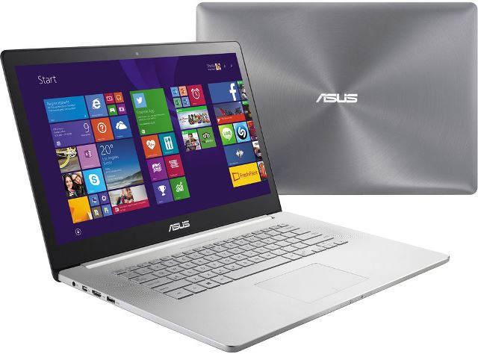
Conspicuous Buy: Asus Laptop
ASUS Zen book NX500JK XH72T 15.6″ Touchscreen Ultra book - Core i7 4712HQ 2.3 GHz - 16 GB RAM - 512 GB SSD – Silver.
Price: $ 2,699
Why is it conspicuous?
Asus is the most popular is a Taiwanese multinational computer hardware and electronics company.
Why is it expensive?
ASUS uses exquisite material like genuine leather.

Slide 9
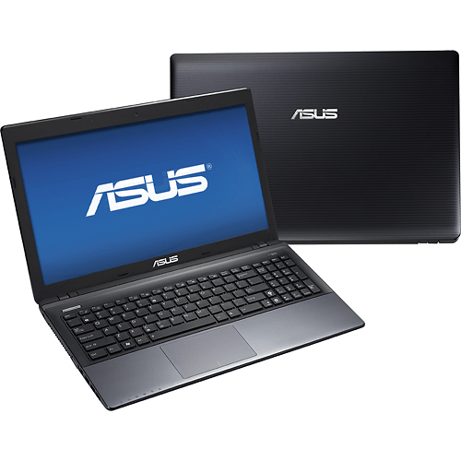
Wise Buy: Asus Laptop
Asus X551MA - 15.6" Laptop - 4GB Memory - 500GB Hard Drive – Black.
Price: $ 261
Why is it wise?
This is less expensive than the other one.
Even if it’s cheap it have the same quality and made from same brand.

Slide 10
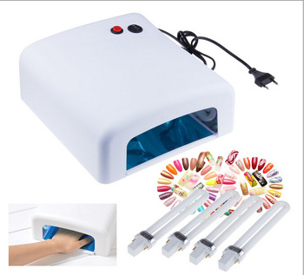
Conspicuous Buy: Nail Dryer
LK-818 36w Professional Nail Dryer Gel Curing Uv Lamp white.
Price: $ 65.01
Why is it conspicuous?
It can quickly dry the nail surface that applies UV TOP Coat, as well as gel nail.
Why is it expensive?
It can be used for setting nail polish and various kind of UV products, such as UV Top Coat / UV Builder Gel / etc.

Slide 11
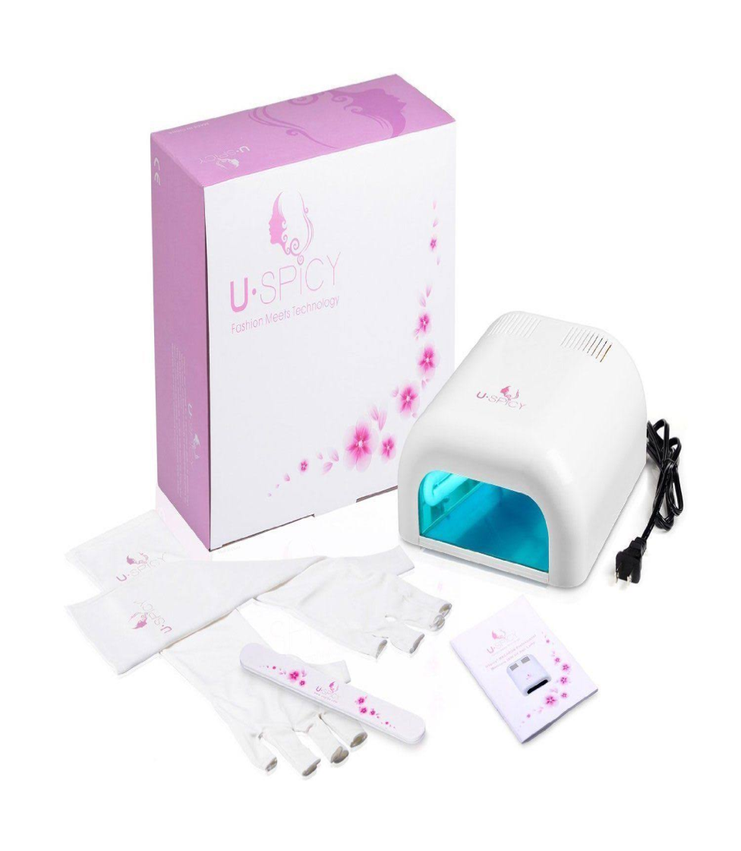
Wise Buy: Nail Dryer
USpicy Macaron USND-3603 UV Gel Lamp Light Nail Dryer White, 36W.
Price: $19
Why is it wise?
I sacrifice my time because it does not dry nail faster but it’s okay.
It’s cheaper than the other one but it have the quality.

Slide 12
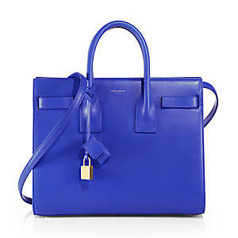
Conspicuous Buy: Women Purse
Saint Laurent Small Sac De Jour Tote - Royal-Blue.
Price: $2,750.00
Why is it conspicuous?
Luxuriously smooth leather carryall translated in a timeless silhouette that reflects the impeccable design ideals of the Yves Saint Laurent heritage.
Why is it expensive?
It’s made of 100% leather and Protective metal feet.
It’s made in Italy.

Slide 13
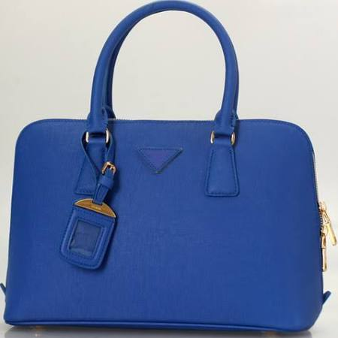
Wise Buy: Leather women purse
Original luxury shell genuine calf leather blue women amber tote handbag purse shoulder bag fashion gift wholesale.
Price: $ 204.55
Why is it wise?
It’s way cheaper but it’s made of same raw material such as 100% leather.
It’s less shiny.

Slide 14
Conspicuous Buy: Prom Dress
Royal Glitter Corset Dress.
Price: $416.99
Why is it conspicuous?
Joil Prom dress is the most popular brand that help girls to stand out and make an impression.
Why is it expensive?
The raw material is expensive.
It has a sheer strapless corset bodice with jeweled overlay and lined bust.

Slide 15
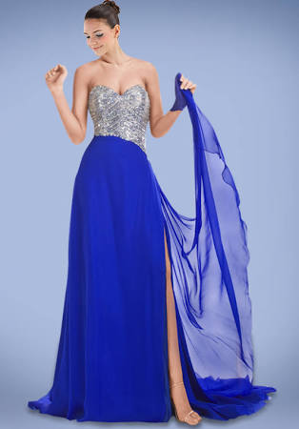
Wise Buy: Prom Dress
Royal Blue Chiffon Prom Gown Accented with Beaded Bodice and Sexy Slit.
Price: $168
Why is it wise?
The design is the same but the price is low.

Slide 16
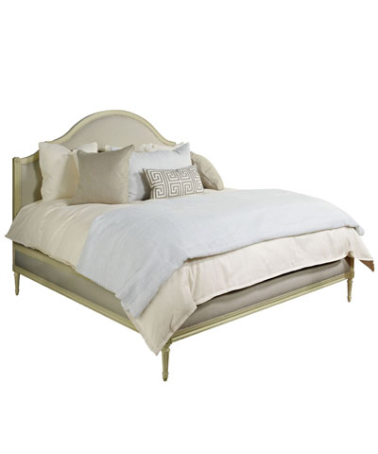
Conspicuous Buy: King Bed
Simone Upholstered King Bed in Birch Paint & Oatmeal.
Price: $8,160.00
Why is it conspicuous?
This bed is designed by Bliss and home design which is the most famous designer brand.
Why is it expensive?
The Simone Bed consists of headboard, footboard, and side rails with luxe fabric padding over all faces.

Slide 17
Wise Buy: Queen size Bed
Bolton Brown Queen Size Uphlster Bed.
Price: $ 156
Why is it wise?
It’s very cheap but the raw material have a high quality.
Bolton has a solid hardwood frame and is supported by black square tapered feet.

Slide 18
Conspicuous Buy: Sunglasses
Dolce Gabbana DG4167 501/8G Sunglasses.
Price: $346.99
Why is it conspicuous?
Dolce & Gabbana is an Italian luxury industry fashion and their product is most wanted in the market.
Why is expensive?
100% Authentic Dolce Gabbana -Includes all original manufacturer packaging.

Slide 19
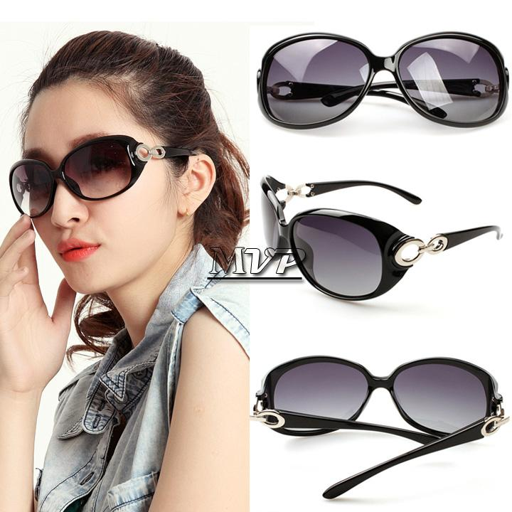
Wise Buy: Women Sunglasses
Women Fashion Summer Sun Glasses Women's Vintage.
Price: $ 6.35
Why is it wise?
It’s less expensive than the other one.
Even though the price is low it buy directly from China Suppliers: Hot Fashion Women's Sun Glasses Retro Designer Big

Slide 20
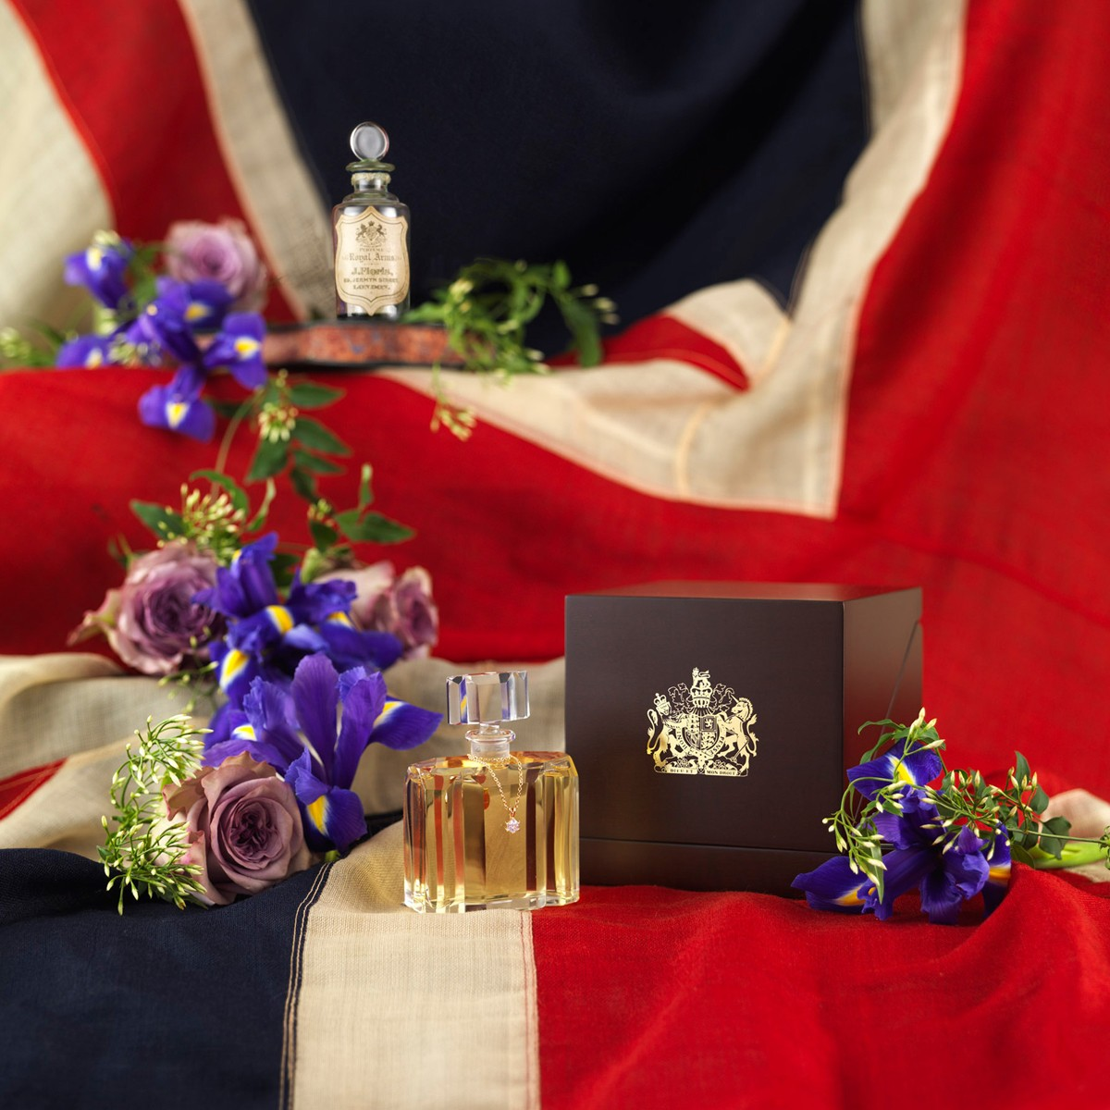
Conspicuous Buy: Perfume
Royal Arms Diamond Edition
Price: $ 25,000.00
Why is it conspicuous?
The heart of this beautifully poised floral fragrance comes from the queen of flowers, the rose. It’s the most wanted kind of perfume in the market.
Why is it expensive?
The bottle is dressed simply with a 50 point Fair-trade white diamond, hand set by a London jeweler.

Slide 21
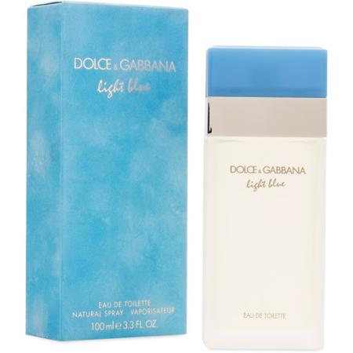
Wise Buy: Perfume
Dolce & Gabbana Light Blue Eau de Toilette Spray for Women - 3.4 fl oz bottle.
Price: $34
Why is it wise?
Even if it’s less expensive but it’s also made in Italy.
It’s a stunning perfume, overwhelming and irresistible like the joy of living.

