Slide 1
Product Research
By Rahel Kindya

Slide 2
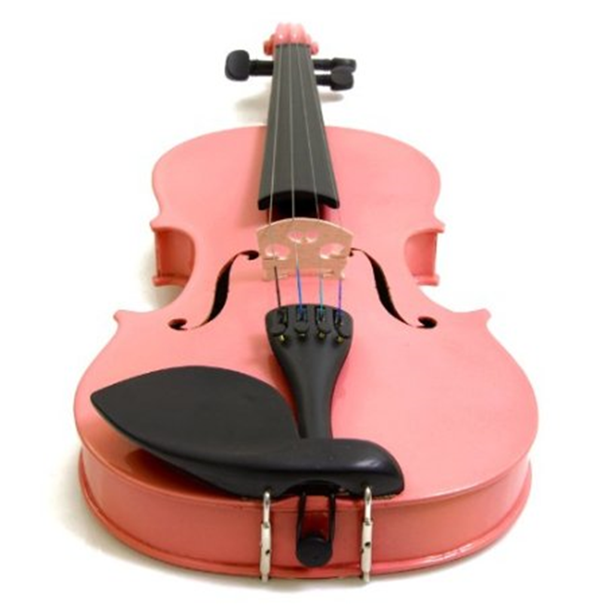
Violin
Price Range: $59.99- 74.14
Product Specs:
Demand factors:
  It’s colorful.
It comes with hard Case, Shoulder Rest, Bow, Rosin and Extra Strings.
Supply factors:
  It’s handmade not manufactured.
  It’s easy to transport.
Elasticity:
  This is an elastic product: if the price increases, people will buy other brands.

Slide 3
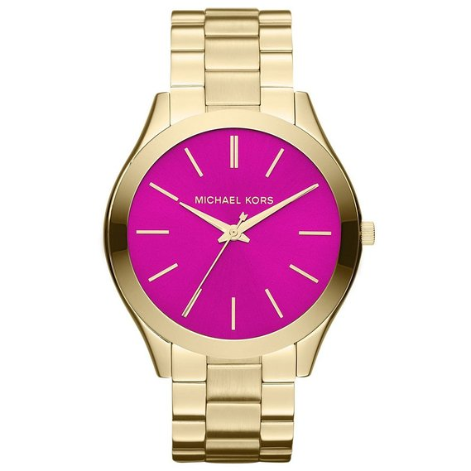
Michael Kors watch
Price Range: $ 101.80- 111.59
Product Specs
Demand factors;
It’s water resistant.
It’s has 2 year warranty.
Supply factors;
It’s a popular company.
It’s manufactured not handmade.
Elasticity;
  This is an elastic product: if the price increases, people will buy other brands.

Slide 4
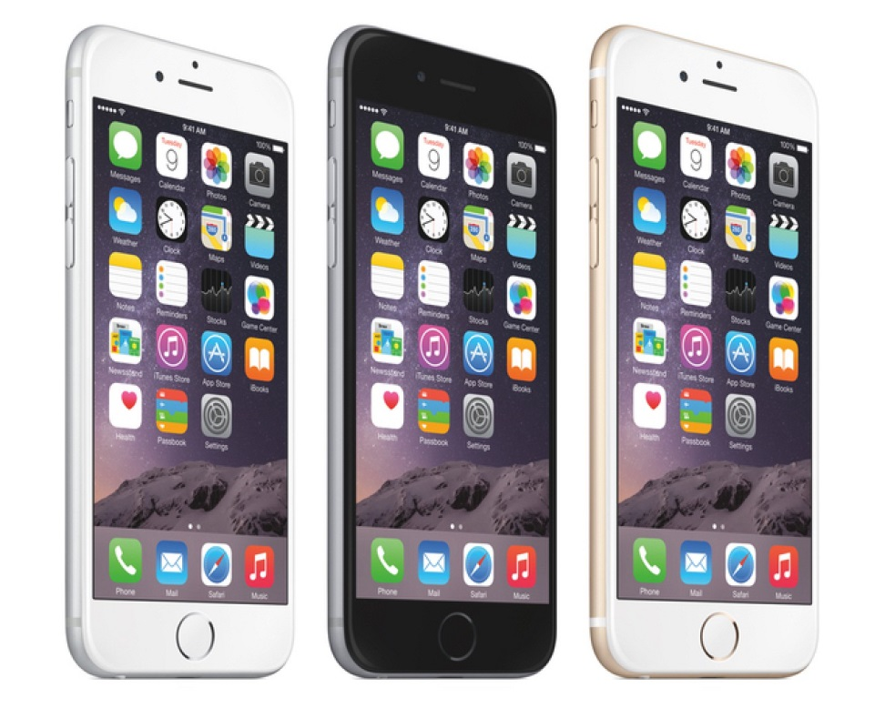
Apple iPhone 6
Price Range: $703.00- 199.99
Product Specs
Demand factors
-

Slide 5
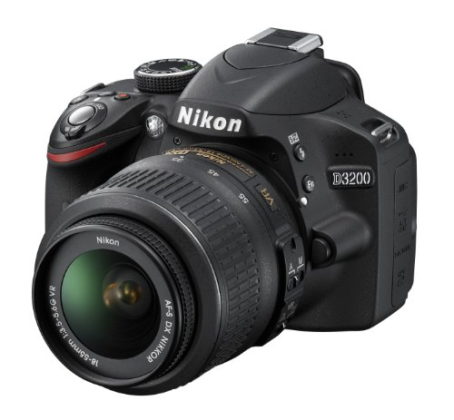
Nikon Camera
Product Specs
Price Range: $209.99-849
Demand Factors:
It comes with Front lens cap, rear lens cap , camera strap (AN-DC3), body cap (BF-1B) and CD-ROM.
It can take awesome picture.
Supply Factors:
It’s manufactured.
It’s made in China and Indonesia.
Elasticity:
This is an inelastic product, if the price increase the demand will also increase.

Slide 6
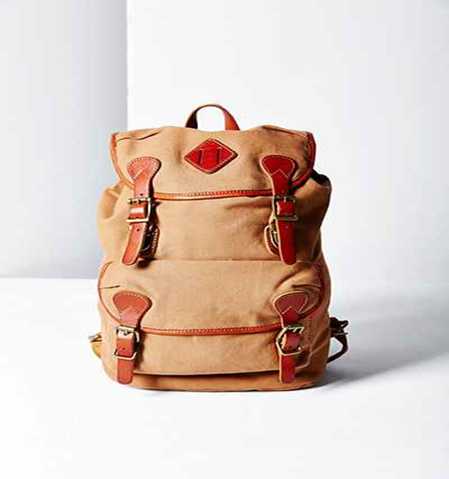
Canvas + Leather Backpack
Price Range:$40.79 – 79.99
Product Specs
Demand factors:
  Girls want classic and fashionable back bag.
  Canvas are popular.
Supply factors:
  Machine washable.
  100% cotton.
Elasticity:
  This is an elastic product: if the price increases, people will buy other brands.

Slide 7
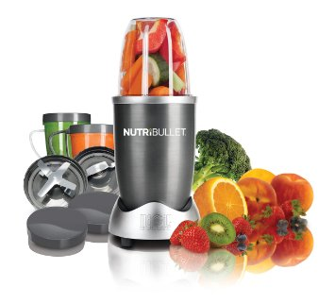
NutriBullet
Product Specs
Price Range: $ 63.99-$135.99
Demand Factors:
Effortlessly pulverizes fruits, vegetables, superfoods and protein shakes.
It cracks through stems, shreds tough skins and breaks down even the toughest.
Supply Factors:
It’s manufactured.
It’s made in China and sell by American company Alchemy worldwide.
Elasticity:
I think this product is inelastic, if the price goes up the consumer will buy it.

Slide 8
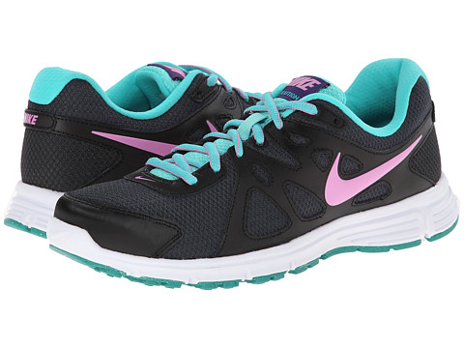
Nike Women's Running Shoe
Price Range:$41.03 - $300.00
Product Specs
Demand Factors:
Padded footbed and Pylon midsole to add to the comfort and support.
Variety of color.
Supply Factors:
China, Vietnam and Indonesia are three major places where Nike shoes are made.
Elasticity:
I think Nike is an elastic product, if the price goes up the consumer will buy another brand.

Slide 9
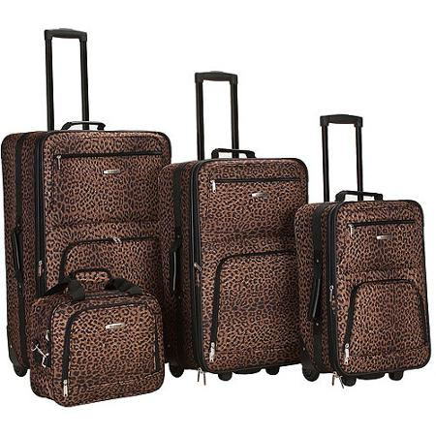
Rockland Four-Piece Luggage Set
Price Range: $142.25-445
Product Specs
Demand Factors:
It have four multi directional spinner wheels rotate 360 degrees for easy maneuverability.
Sturdy ergonomic aluminum telescoping handle.
Supply Factors:
It’s 100% plastic.
It’s also machine wash.
Elasticity:
This product is elastic if the prices rise up the buyer will purchase another brand.

Slide 10
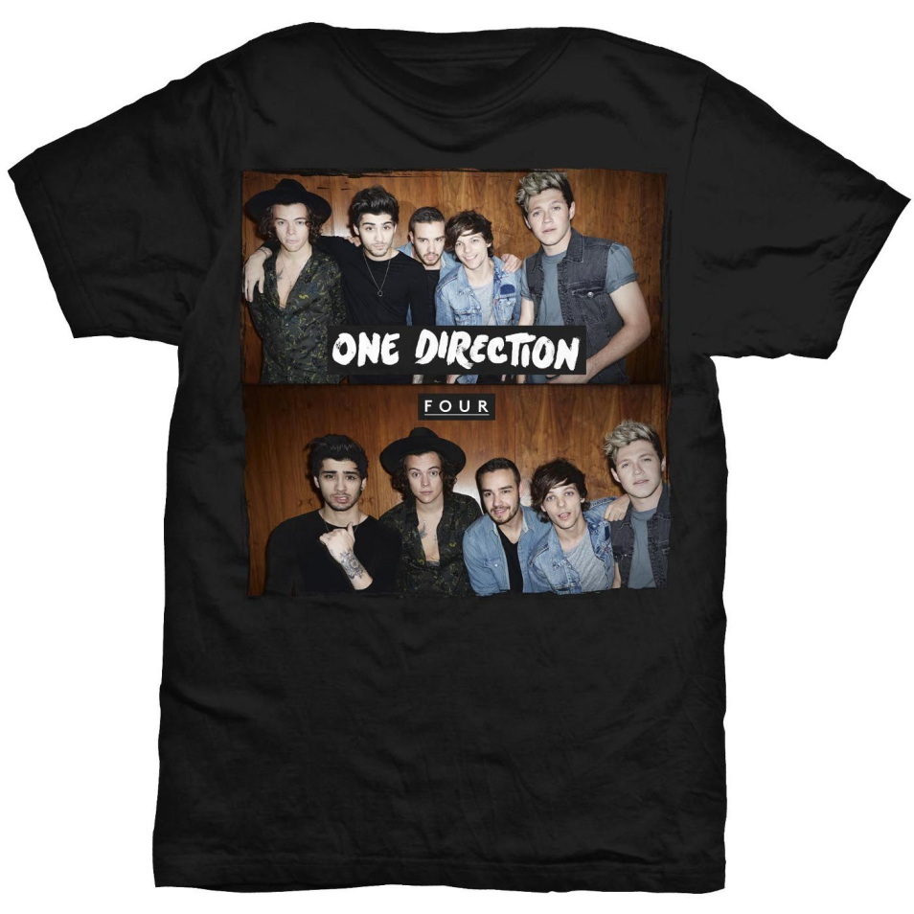
One Direction T-Shirt
Price Range: $22.50 - 27.44
Product Specs
Demand Factors:

