Slide 1
Credit Card Comparison
By Rahel Kindya

Slide 2
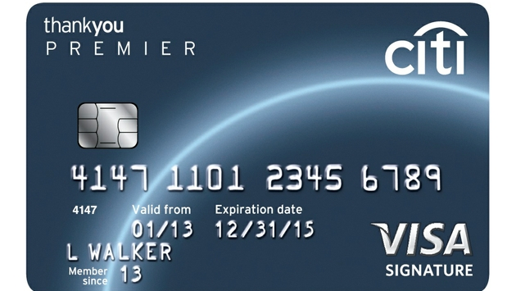
CITI THANK YOU PREMIER CARD
This is a REWARDS CARD
Annual Fee: you pay $95 a year, but the first year is free
Rewards: 1 point per dollar
APR: Variable %14-23
Introductory APR: N/A
BALANCE TRANSFER: N/A
Why would you want this card?
This card offers you good points for making purchases. It’s a good rewards card. However, there is a fee and the interest rate is high.

Slide 3
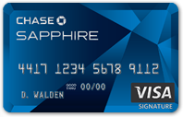
Chase Sapphire Preferred® Card
This is a reward card.
Annual fee: you pay $95 a year but the first year is free.
Rewards: 1.00%
APR: 15.99% Variables
Introductory APR: N/A
Balance Transfer: N/A
Why would you want this card?
A large sign-up bonus
No foreign transaction fee
Cool factor - metal card

Slide 4
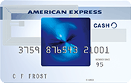
Blue Cash Preferred® Card from American Express
This is Cash Back Credit Cards
Annual Fee = $75
Rewards = 1.0%
APR: 12.99-21.99%
Introductory APR: 0% intro APR on purchases and balance transfers for 15 months.
Balance Transfer: N/A
Why would you want this card?
It has Hassle-free cash back: no enrollment required, the same great reward categories year-round.

Slide 5
Union Bank Platinum Edition Visa Card
This is a Balance Transfer Credit card.
Annual Fee: $0
Rewards: 0%
APR: 9.9-17%
Introductory APR:
Purchase: 0% for 12 months.
Transfer: 0% for 12 months.
Balance Transfer: N/A
Why would you want this card?
No annual fee
0% for 12 months on transfers

Slide 6
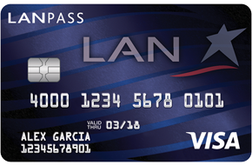
US Bank LANPASS Visa Card
This is a travel credit card.
Annual fee: 0% the first year, then $45.
Rewards: 1.0%
APR: 12.9-19.99%
Introductory APR: N/A
Balance transfer: N/A
Why would you want this card?
Earn 1 mile per $1 spent on purchases
2,000 Bonus Miles with annual renewal

Slide 7
First National Omaha Platinum Edition Visa Card
This is a Zero percent credit Cards.
Annual fee: 0%
Rewards: 0%
APR: 9.99-17.99%
Introductory APR: Purchase 0% for one year, transfer 0% for 12 months.
Balance Transfer: N/A
Why would you want this card?
No annual fee.
0% for 12 months on transfer.

Slide 8
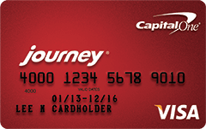
Journey Student Rewards from Capital One
This is a student credit cards.
Annual fee: $0
Rewards: 1.25%
APR: 19.8% Variable
Introductory APR: N/A
Balance transfer: N/A
Why would you want this card?
There’s no limit to the amount of cash back you can earn, and rewards don't expire.

Slide 9
Ink Plus Business Credit Card
This is a Business Credit cards.
Annual Fee: 0% for the first year then, $95
Rewards: 1.00%
APR: 15.24% variable
Introductory APR: N/A
Balance transfer: N/A
Why would you want this card?
No foreign transaction fee.

Slide 10
Somerset Trust Company Community Visa Gold
This is a low Interest Credit cards.
Annual Fee: $0
Rewards: 0%
APR: 10.9%
Introductory APR: Purchase: 3.90% for 6 months, transfer: None.
BALANCE TRANSFER: N/A
Why would you want this card?
Because it qualify with average credit and no annual fee

