Slide 1
Country Profile
By, Rahel Kindya

Slide 2
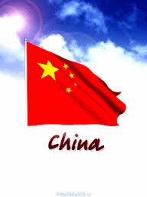
china
Exports | %
Computers | 9.9
Broadcasting equipment | 5.2
Telephones | 4.3
Office equipment | 2.2
Integrated circuit | 2.0
This is a profile of China. It is the richest country in the region of Central Asia. The GDP of China is approximately 18.976 trillion dollars per year.

Slide 3

JAPAN
Exports | %
Cars | 13
Vehicle parts | 5.3
Integrated circuit | 2.4
Industrial printers | 2.2
Machine having specific role | 1.7
This is a profile of Japan. It is the 2nd richest country in the region of east Asia. The GDP of Japan is approximately 4.843 trillion dollars per year.

Slide 4

South Korea
Exports | %
Refined petroleum | 9.2
Integrated circuit | 8.7
Cars | 7.6
Passenger & cargo ship | 5.2
LCDs | 4.3
This is a profile of South Korea. It is the middle-income country in the region of East Asia. The GDP of South Korea is approximately 1.789 trillion dollars per year.

Slide 5

North Korea
Exports | %
Coal briquettes | 39
Iron ore | 7.8
Non-knit women’s coats | 3.7
Non-knit men’s suits | 3.6
Non-knit men’s coats | 3.5
This is a profile of North Korea. It is the poorest country in the region of East Asia. The GDP of North Korea is approximately 40 billion dollars per year.

