Slide 1
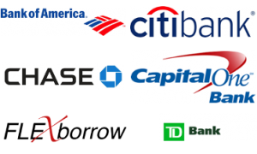
Bank Comparison
By Rahel Kindya

Slide 2
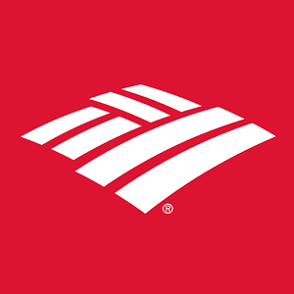
Bank of America Rewards Money Market
Where is it?
It is from a traditional bank but has online access.
APY .03
Minimum Balance to Open = $25
Fees = no fee if you have a balance of $2,500 or $12 Monthly Fee
Transaction Limit: 6 transactions per month
Why is it good?
–It has the highest interest rates of all BOA accounts

Slide 3
Capital One Bank
Where is it?
It has online access.
APY 0.75%
Minimum Balance to Open = $0.00
Fees = no fee
Transaction Limit: 6 transactions per month
Why is it good?
No changing banks.
No fees.
No minimums.

Slide 4
Synchrony Bank
Where is it?
It is from a traditional bank but has online access.
APY 1.05%
Minimum Balance to Open = $0.00
Fees = no fee
Transaction Limit: 6 transactions per month
Why is it good?
Member FDIC
ID theft resolution service.
Synchrony Bank was formerly GE Capital Retail Bank.

Slide 5
Ally Bank money market
Where is it?
It is from a traditional bank but has online access.
APY .99%
Minimum Balance to Open = $0.00
Fees = no monthly fees.
Transaction Limit: 6 transactions per month
Why is it good?
No minimum deposit to open.
No monthly maintenance fees.
Member FDIC.

Slide 6
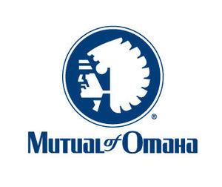
Mutual of Omaha money market
Where is it?
It is from a traditional bank but has online access.
APY .85%
Minimum Balance to Open = $1,000
Fees = no monthly fee.
Transaction Limit: 6 transactions per month
Why is it good?
Easy to open. Easy to fund. Easy to manage.
Free online banking and eStatements.
National network of free ATMs.

Slide 7
Chase Bank
Where is it?
It is from a traditional bank but has online access.
APY= $250 bonus
Minimum Balance to Open = $25
Fees = no fee If you have a balance of $2,500 or $12 Monthly Fee.
Transaction Limit: 6 transactions per month
Why is it good?
Earn $250 for opening a Chasing savings.
Chase total checking.

